Slide 1
Progress of Application of Rare Earth in Catalytic Materials and New Energy Field 稀土在催化材料和新能源领域的应用进展
Runsheng Zhuo, Professor
President of Rezel Catalysts Corporation
May 27, 2021

Slide 2
‘Rare earth’, a general term for 17 mineral elements in the periodic table, have seen increasing use, and have become known as "industrial vitamins”.
稀土是元素周期表中17种矿物元素的总称，用途日益广泛，被称为“工业维生素”
We would like to discuss:我们想讨论：
Current status of rare earth elements稀土元素现状。
Progress of applications of rare earth materials in catalysis稀土材料在催化中的应用进展
Progress of applications of rare earth materials in new energy field稀土材料在新能源领域的应用进展
Future perspectives未来展望

Slide 3
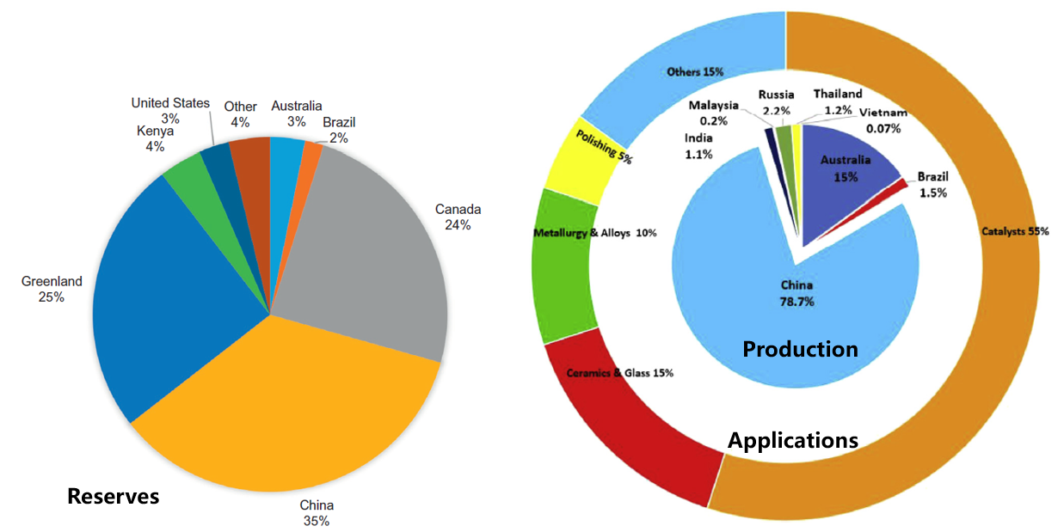
1. Status of Rare Earth Elements
- Reserves, Their Production and Applications
稀土元素现状 - 储量，生产和应用
生产
应用
储量

Slide 4
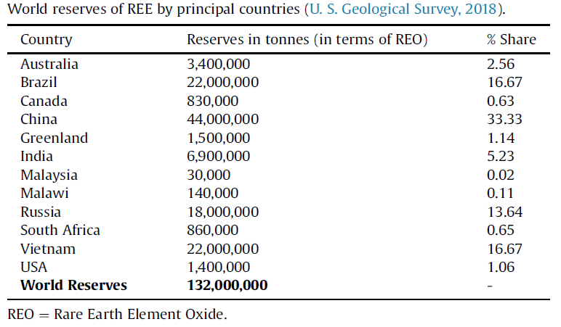
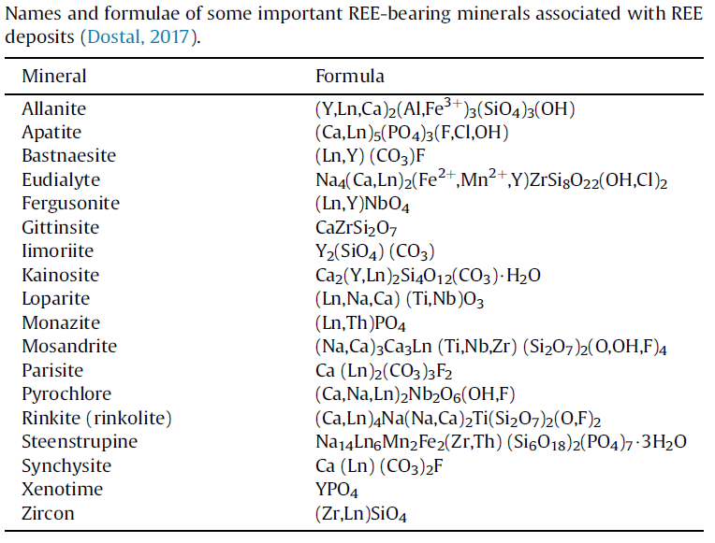
Details of the Rare Earth Reserves 稀土储量明细

Slide 5
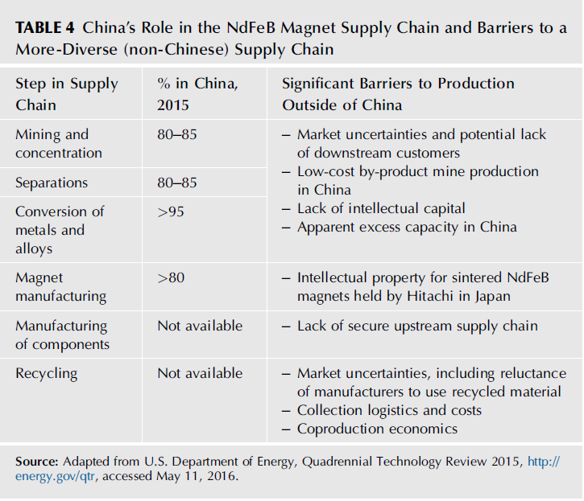
China is leading in the rare earth production due to their various developed technologies
由于技术的发展，中国在稀土生产方面处于领先地位
Example:

Slide 6
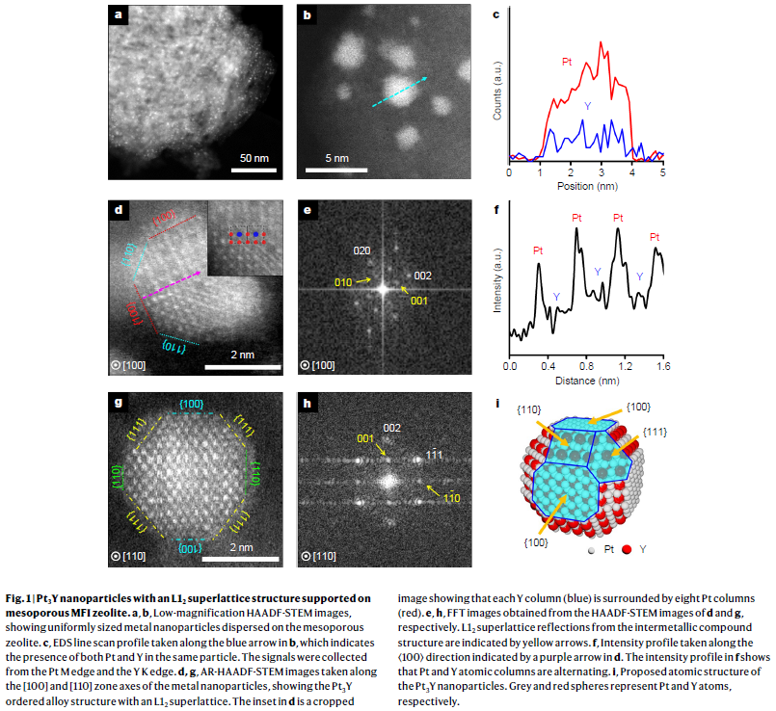
2. Progress of Applications of Rare Earth Materials in Catalysis
- Continuously Widely Used as a Major Component
稀土材料在催化中的应用进展-作为主要组分持续广泛使用
Development in Materials:材料开发：
Metal-rare earth alloys金属-稀土合金
Mixed metal oxides混合金属氧化物
Nano-precious metals and nano rare-earth oxides纳米贵金属和纳米稀土氧化物
Rare-earth metal–organic frameworks
稀土金属-有机框架
Rare-earth triflates稀土三氟甲基磺酸盐
Rare-earth containing polyoxometalate
含稀土多金属氧酸盐

Slide 7
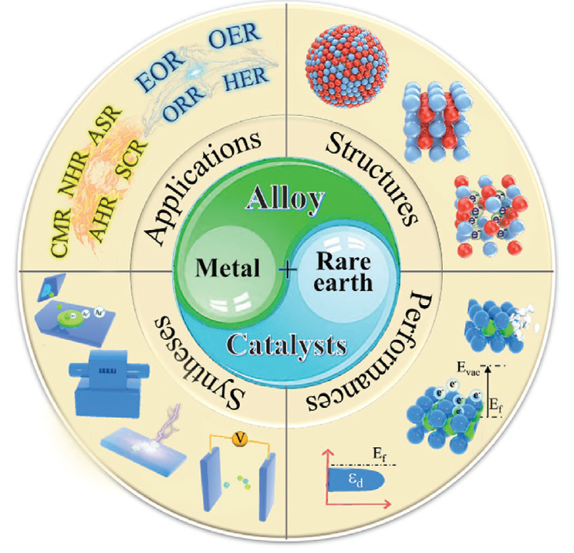
Metal-Rare Earth Alloys金属-稀土合金
- Electrocatalytic Reactions 电催化反应
HER: Hydrogen evolution reaction析氢反应
OER: Oxygen evolution reaction析氧反应
ORR: Oxygen reduction reaction氧还原反应
EOR: Ethanol oxidation reaction乙醇氧化反应
- Thermocatalytic Reactions 热催化反应
AHR: Alkene hydrogenation reaction烯烃加氢反应
CMR: CO2 methanation reaction CO2甲烷化反应
NHR: Nitroarene hydrogenation reaction硝基芳烃加氢反应
ASR: Ammonia synthesis reaction氨合成反应
SCR: Suzuki coupling reaction 铃木耦合反应
Rare‐Earth Incorporated Alloy Catalysts: Synthesis, Properties, and Applications
Adv. Mater. 2021
Shuai Zhang，Sandra Elizabeth Saji ，Zongyou Yin，Hongbo Zhang，Yaping Du，Chun‐Hua Yan
https://doi.org/10.1002/adma.202005988
Schematic illustration of the structures, performance, synthesis and applications of RE-containing alloy catalysts
稀土合金催化剂的结构、性能、合成及应用示意图

Slide 8
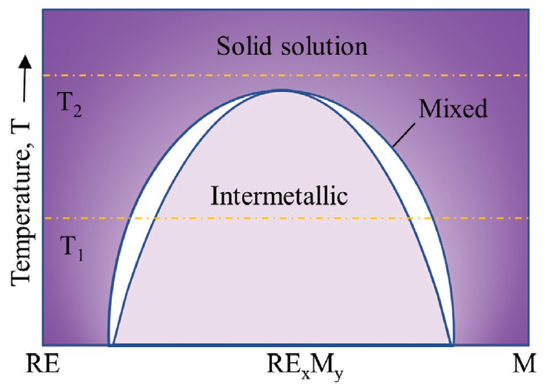
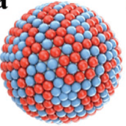
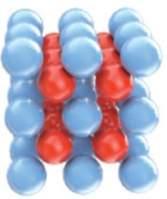
Phase Diagram of Metal-Rare Earth Alloys
金属-稀土合金相图
固熔体
混合物
金属间化合物

Slide 9
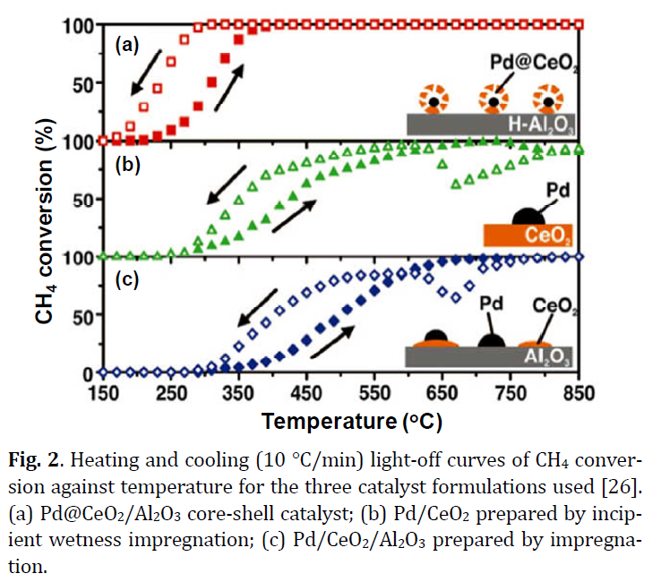
Nano-Precious Metals and Nano Rare-Earth Oxides
纳米贵金属和纳米稀土氧化物
Core – shell核壳法
Incipient wetness
Impregnation
微湿含浸法
Conventional
Impregnation
常规浸渍法

Slide 10
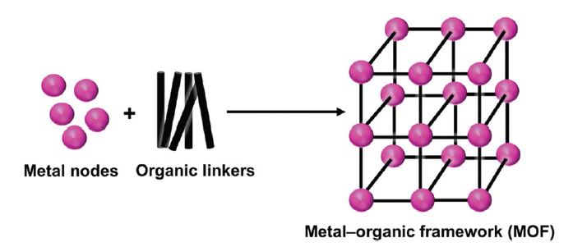
Rare-Earth Metal–Organic Frameworks稀土金属-有机框架
金属节 有机链
Metal ions
Metal chains
Metal clusters
Many organic acids
with coordinating functions 多种具有配位功能的有机酸
金属离子，金属链，金属簇
Catalysis – Unsaturated Coordination – Accessible Lewis acid sites
催化-不饱和配位-易接近路易斯酸位点
CO2 valorization, Carbon-carbon bond formation, Oxidation, Polymerization, Condensation二氧化碳的高值化，
碳碳键的形成，氧化，聚合，缩合
Felix Saraci, Victor Quezada-Novoa, P. Rafael Donnarumma and Ashlee J. Howarth
Chem. Soc. Rev., 2020,49, 7949-7977

Slide 11
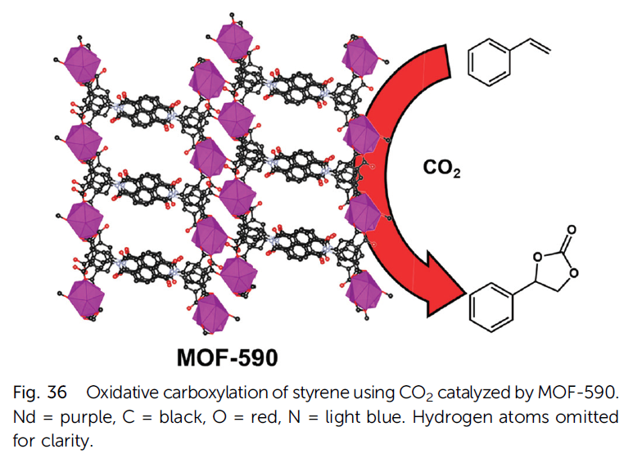
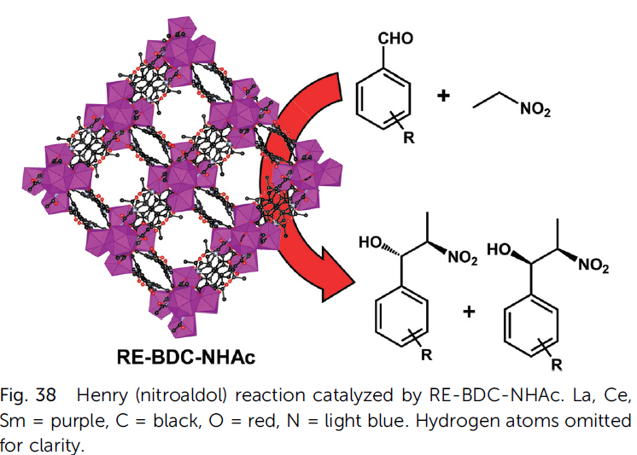
Various Rare-Earth Metal–Organic Frameworks
各种各样的稀土金属-有机框架
Felix Saraci, Victor Quezada-Novoa, P. Rafael Donnarumma and Ashlee J. Howarth
Chem. Soc. Rev., 2020,49, 7949-7977

Slide 12
Rare-Earth Triflates
Sc, Y, La-Lu triflates，Ln(OTf)₃
OTf = CF3SO3 – )
稀土三氟甲基磺酸盐
Act as Lewis acids in aqueous medium, stable in water and active catalysts for organic synthesis.在水介质中作为路易斯酸，在水中稳定，是有机合成的活性催化剂。
Highly active for chloromethylation of many aromatic hydrocarbons which are key intermediates for many fine chemicals, pharmaceuticals and polymers.
对许多芳香烃的氯甲基化具有高度活性，芳香烃是许多精细化学品、药物和聚合物的关键中间体。
Hard Lewis acids硬路易斯酸
More soluble in water than in organic solvents such as dichloromethane. Almost 100% of the Ln(OTf)₃ was quite easily recovered from the aqueous layer after the reaction was completed, and it could be reused.比二氯甲烷等有机溶剂更易溶于水。几乎100%的Ln（OTf）3 反应完成后很容易从水层中回收，可以重复使用。
The chloromethylation of m-xylene catalyzed by Sc(OTf)3 gave 2,5-bis(chloromethyl)-m-xylene with 1,2,4,5-substitution, which is expected to be a key intermediate for pyromellitic dianhydride. The catalysis occurred via the formation of a chloromethylated triflate complex, and electrophilic addition to an aromatic hydrocarbon.
Sc（OTf）3催化间二甲苯的氯甲基化反应生成2,5-二（氯甲基）-1,2,4,5-取代间二甲苯，有望成为均苯四甲酸二酐的关键中间体。催化作用是通过氯甲基化的三氟酸盐络合物的形成和芳香烃的亲电加成来实现的。

Slide 13
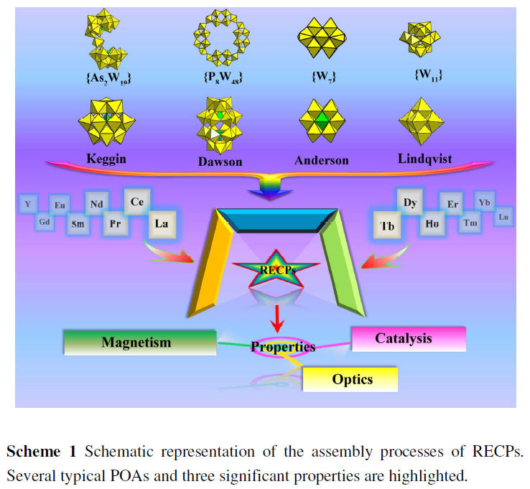
Rare-Earth Containing Polyoxometalate含稀土多金属氧酸盐
Xing Ma, Wen Yang, Lijuan Chen* and Junwei Zhao
CrystEngComm, 2015,17, 8175-8197

Slide 14
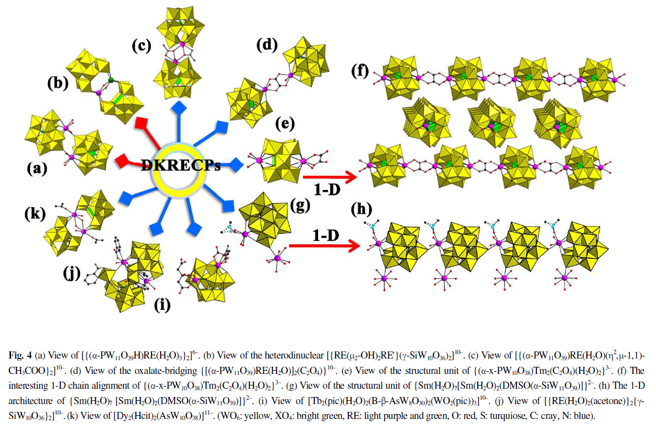
RE-Polyoxometalates稀土多金属氧酸盐
Various connections
各种链接
Xing Ma, Wen Yang, Lijuan Chen* and Junwei Zhao
CrystEngComm, 2015,17, 8175-8197

Slide 15
Expanding of Application Fields in Catalysis:
Petroleum Cracking Catalysis
Environmental Catalysis
Single-atom Site Catalysis
Electrocatalysis
Heterogeneous Photocatalysis
Rare-earth Metal Triflates-catalyzed Organic Reactions
Biomass conversion
催化应用领域拓展：
石油裂解催化
环境催化
单原子位催化
电催化
多相光催化
稀土金属三氟甲基硫磺酸化合物催化的有机反应
生物质转化

Slide 16
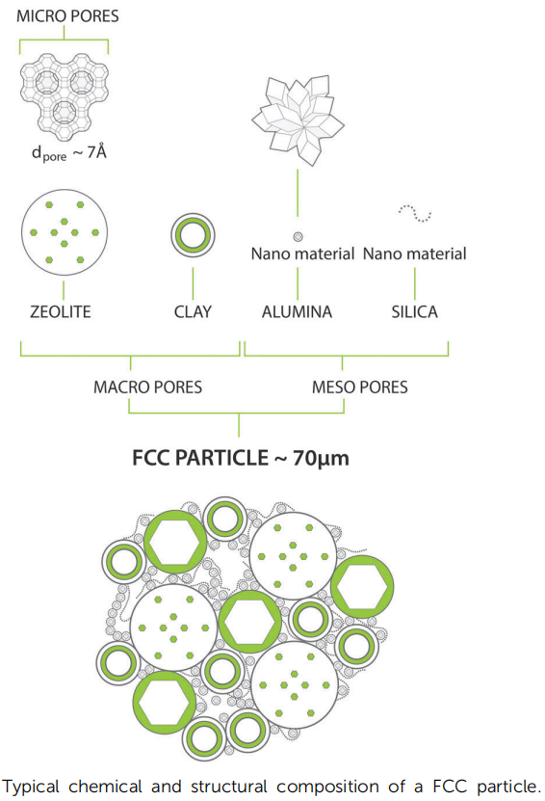
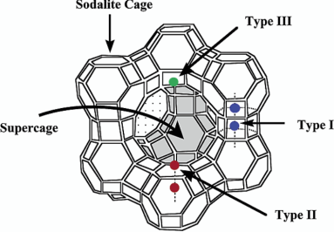
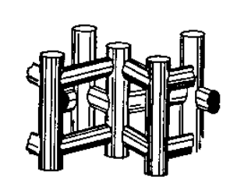
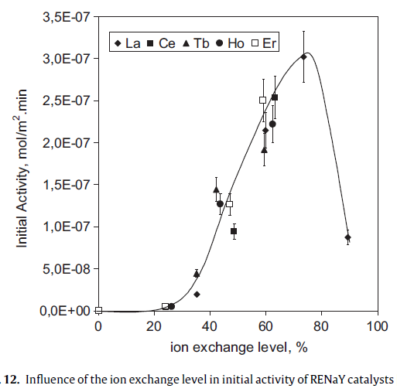
Petroleum Cracking Catalysis石油裂解催化
Microsphere
Zeolite Components
Rare Earth on Matrix
Metal trapping
微球
沸石组分
金属俘获
ZeoliteY
ZSM-5
沸石中的稀土沸石结构和酸中心的稳定化蒸汽老化后仍保留更多的酸度
氢化物转移
Rare Earth in Zeolites
Stabilization of zeolite structure and acid sites
More acidity remaining after steam-aging
Hydride transfer
Use of less rare earth ions使用较少的稀土离子
离子交换水平对RENaY催化初始活性的影响
E. T. C. Vogt and B. M. Weckhuysen Chem. Soc. Rev., 2015, 44, 7342--7370

Slide 17
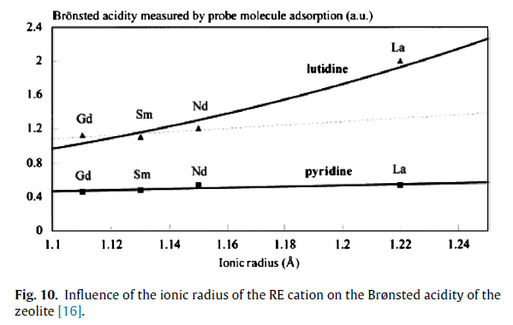
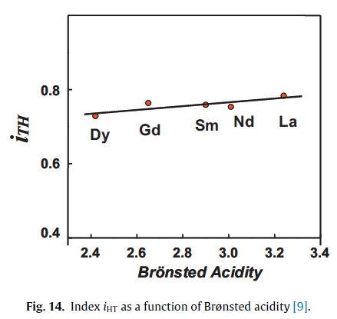
Correlation of Ionic Radius of RE Elements and IHT
稀土离子半径与IHT的关系
氢转移指数（H）。该指数随稀土离子半径的增大而增大。稀土通过增加沸石的酸性来增加HT。稀土原子的离子半径越大，沸石的溴化度越高，HT也越高。在工业界，在催化剂中引入稀土会带来更高的HT，从而降低烯烃浓度。这样的下降导致汽油消耗量减少。尽管MON不受影响，但它也可能起到V型陷阱的作用
Hydrogen Transfer Index ( H ) . Such index increases with the increasing ionic radius of the RE atom . RE increase HT by increasing zeolite acidity.
The higher the ionic radius of the RE atom , the higher the Bronstedacidity of the zeolite , and the higher the HT.
In the industrial world , introduction of RE in the catalysts brings about higher HT , hence a drop in olefin concentration . Such dropcauses a reduction in gasoline RON . although MON remains unaffected.
RE may also act as a V-trap.

Slide 18
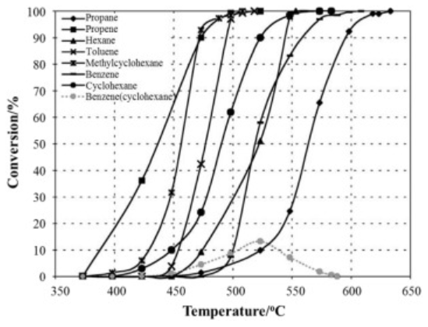
Environmental Catalysis 环境催化
Volatile organic compounds (VOCs) are one of the main sources of air pollution, which are from industrial activities, such as motor vehicles, ship building, spray paint, chemical and printing, footwear and pharmaceuticals, rubber and plastics processing, kitchen fume, and etc.挥发性有机化合物（VOCs）是大气污染的主要来源之一，主要来源于工业活动，如机动车、造船、喷漆、化工印刷、制鞋医药、橡塑加工、厨房油烟等。
VOCs include light hydrocarbons, aromatics, alcohols, ketones, ethers, esters, aldehydes, carboxylic acids, amines, and halogen-containing organic substances.挥发性有机化合物包括轻烃、芳烃、醇类、酮类、醚类、酯类、醛类、羧酸类、胺类和含卤素的有机物。
The materials used in environmental catalysis for
the removal of typical VOCs, methane, carbon monoxide,
soot, automotive exhaust, and nitrogen oxides include
环境催化材料去除典型的挥发性有机化合物，甲烷，一氧化碳，烟尘、汽车尾气和氮氧化物包括
- Rare earth oxides,
- Mixed rare earth oxide, -混合稀土氧化物
- Rare earth oxide-supported noble metal, -稀土氧化物为载体的贵金属
- Mixed rare earth oxide-supported noble metal catalysts
-稀土氧化物
Conversion of hydrocarbons and product yields on La0_{.8}Sr_{0.2}MnO_{3+x} versus reaction temperature ([HC] = 500 ppm [O₂] = 21 vol%, SV = 20000 h⁻¹) La0.8Sr0.2MnO3+x催化剂上烃类转化及产物产率与反应温度
V. Blasin-Aubé, J. Belkouch, L. Monceaux
General study of catalytic oxidation of various VOCs over La0.8Sr0.2MnO3+x perovskite catalyst−influence of mixture
Appl Catal, B, 43 (2003), p. 175
混合稀土氧化物为载体的贵金属催化剂

Slide 19
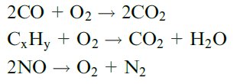
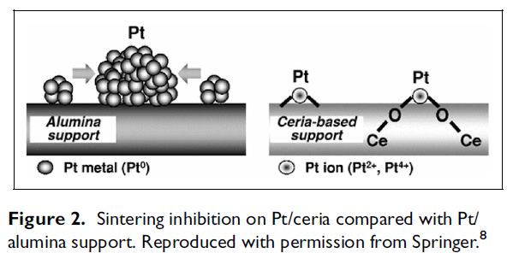
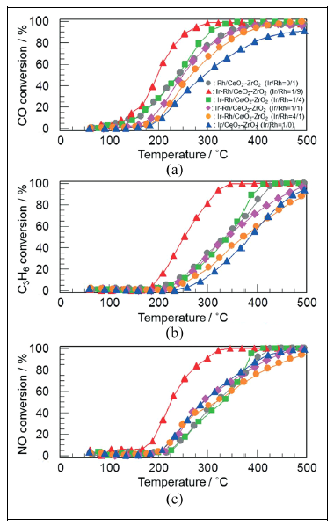
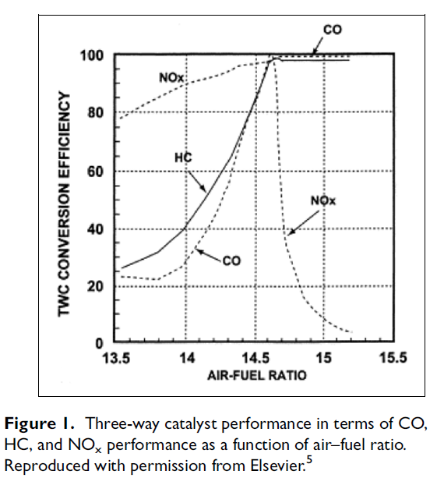
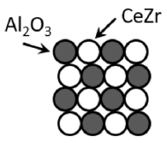
Application in TWC 在三效催化剂中的应用
Rare earth oxides stabilize PGM
稀土氧化物稳定贵金属
Alumina and Rare earth oxide composite
氧化铝和稀土氧化物复合物

Slide 20
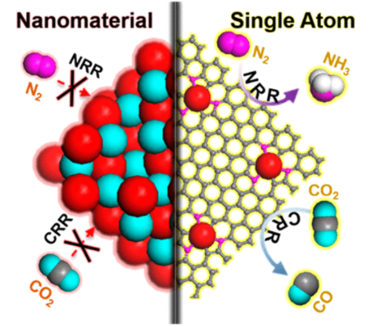
Single-atom Site Catalysis
Nitrogen and Carbon Dioxide Reduction
Synthesis Methods for Single Site Catalysts:
单位点催化剂的合成方法：
Wet chemical methods湿化学法
Atoms trapping原子俘获
Atomic layer deposition原子层沉积
Hydrothermal treatment水热处理
Atom confinement and coordination原子限制与配位
氮和二氧化碳还原
Jieyuan Liu, Xue Kong, Lirong Zheng, Xu Guo, Xiaofang Liu, and Jianglan Shui
ACS Nano 2020 14 (1), 1093-1101

Slide 21
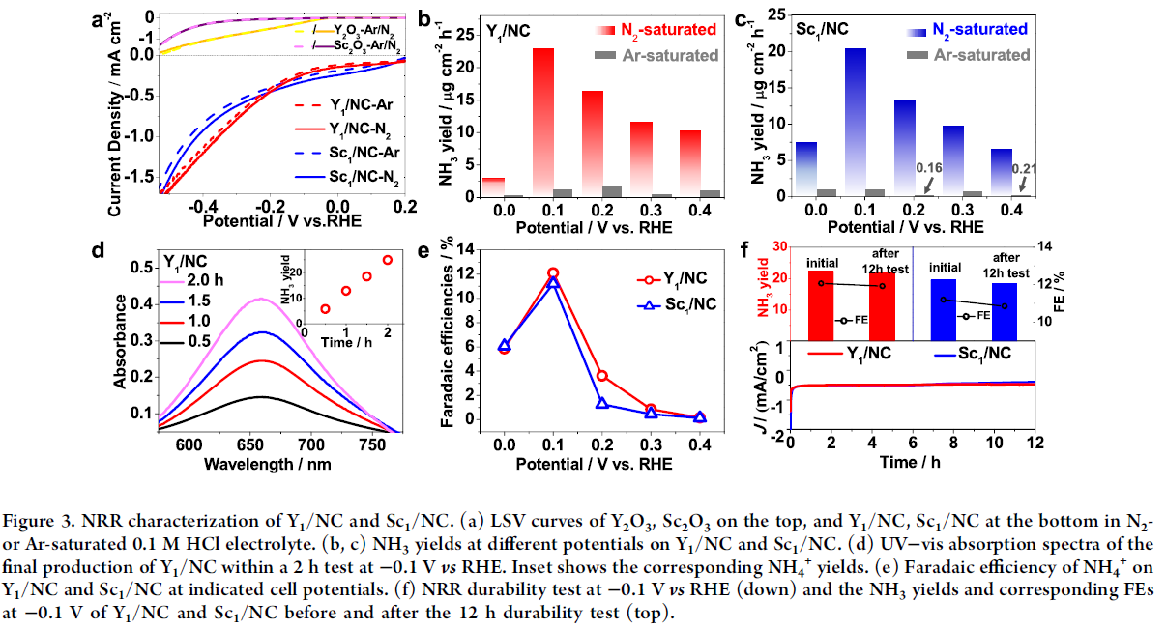
Nitrogen reduction to NH3
氮还原成氨
Jieyuan Liu, Xue Kong, Lirong Zheng, Xu Guo, Xiaofang Liu, and Jianglan Shui
ACS Nano 2020 14 (1), 1093-1101

Slide 22
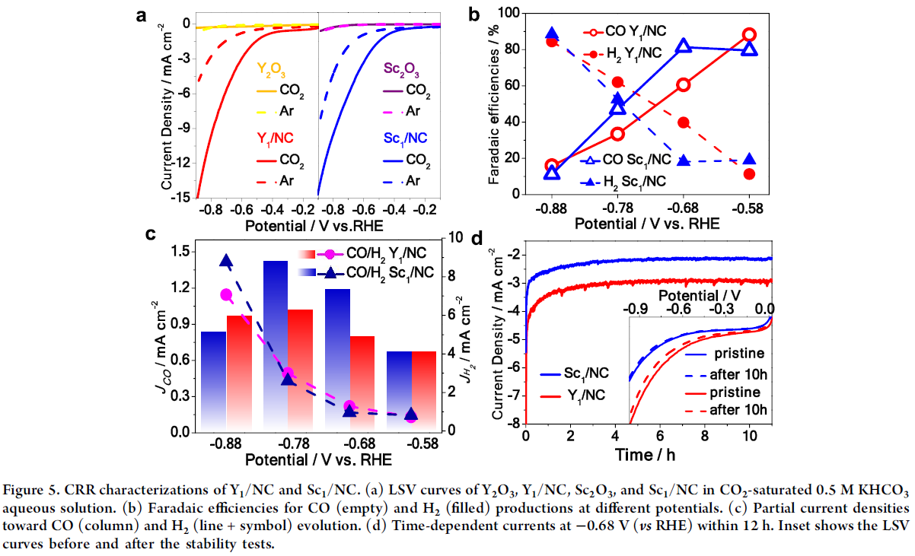
CO2 reduction to CO
CO2 还原成CO
Jieyuan Liu, Xue Kong, Lirong Zheng, Xu Guo, Xiaofang Liu, and Jianglan Shui
ACS Nano 2020 14 (1), 1093-1101

Slide 23
The synthesis methods and applications of REM-containing SASCs 含稀土的单原子单位点催化剂的合成方法及应用
Catalysts | Rare earth compounds | Synthetic methods | Application | Year
Pt/CeO₂ | CeO₂ | Wet chemical methods, leached | Water-gas shift reactions | 2003
Au/CeO₂ | CeO₂ | Wet chemical methods, leached | Water-gas shift reactions | 2003
CeO₂–Pt/La–Al₂O₃ | CeO₂, La | Atoms trapping | CO oxidation | 2009
Pt/CeO₂ | CeO₂ | Atomic layer deposition | CO oxidation | 2017
Pt/CeO₂ | CeO₂ | Hydrothermal treatment | CO oxidation and diesel oxidation catalytic reaction | 2017
Rh/CeO₂ | CeO₂ | Hydrothermal treatment | Diesel oxidation catalytic reaction | 2018
Pt/CeO₂ | CeO₂ | Wet chemical methods | CO₂ electro-reduction | 2018
Pt/CeO₂ | CeO₂ | Atomic layer deposition | Dehydrogenation of ammonia borane | 2019
Er₁/CN-NT | Er | ACC | CO₂ photo-reduction | 2020
Ce–MnO₂ | CeO₂ | ion-exchange approach | NH₃-SCR | 2020
Ningqiang Zhang, HanYan, Lingcong Li, RuiWu, Liyun Song, Guizhen Zhang, Wenjun Liang, Hong He
Journal of Rare Earths, 39, 2021, 233-242

Slide 24
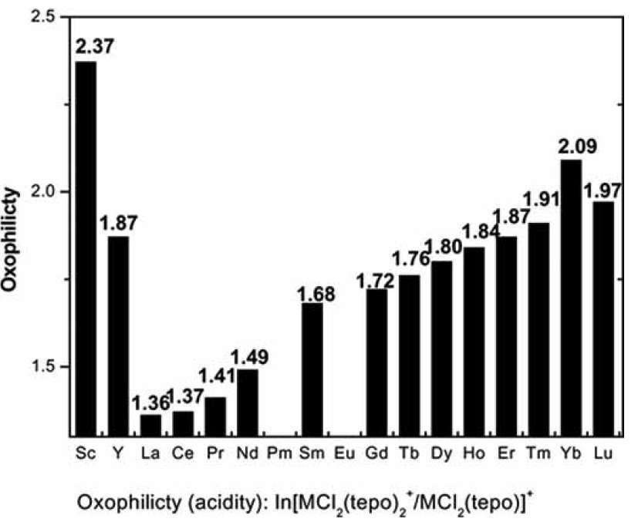
Rare-earth Triflates
稀土三氟磺酸盐
Act as Lewis acids in aqueous medium, stable in water and active catalysts for organic synthesis.在水介质中作为路易斯酸，在水中稳定，是有机合成的活性催化剂。
Highly active for chloromethylation of many aromatic hydrocarbons which are key intermediates for many fine chemicals, pharmaceuticals and polymers.
对许多芳香烃的氯甲基化具有高度活性，芳香烃是许多精细化学品、药物和聚合物的关键中间体。
Sc, Y, La-Lu triflates，Ln(OTf)₃
hard Lewis acids
OTf = CF3SO3 – )
More soluble in water than in organic solvents such as dichloromethane. Almost 100% of the Ln(OTf)₃ was quite easily recovered from the aqueous layer after the reaction was completed, and it could be reused
比二氯甲烷等有机溶剂更易溶于水。几乎100%的Ln（OTf）3 反应完成后很容易从水层中回收，可以重复使用
Potent environmentally-benign Lewis acids
强效环保路易斯酸
Acidity scale of RE-(OTf)3

Slide 25
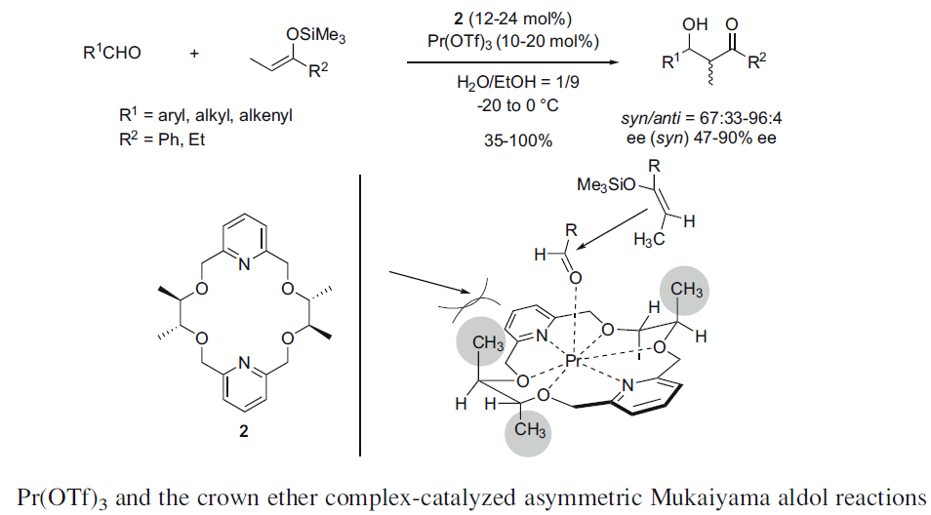
Chiral Lewis Acid Rare-earth Metal Complexes
手性路易斯酸稀土金属配合物
Enantioselective Catalysis
对映选择性催化
Asymmetric aldol reaction不对称aldol反应
Asymmetric Mannich reaction不对称Mannich反应
Asymmetric Michael reaction不对称Michael反应
Asymmetric Friedel-Crafts reaction不对称Friedel-Crafts反应
Asymmetric homologation of carbonyl compounds with α-diazoesters羰基化合物的不对称同系物α-重氮酯
Asymmetric ene-type reaction不对称烯型反应
Asymmetric cycloaddition reaction不对称环加成反应
Asymmetric ring-opening reaction不对称开环反应
Asymmetric miscellaneous reaction不对称杂环反应
Xiaoming Feng, Zhen Wang and Xiaohua Liu
Chiral Lewis Acids, pp 147-191

Slide 26
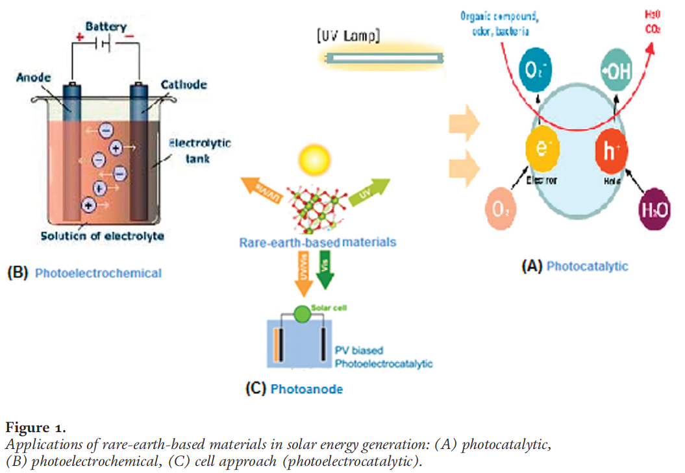
Heterogeneous Photocatalysis
– Degrade organic and inorganic pollutants降解有机和无机污染物
多相光催化

Slide 27
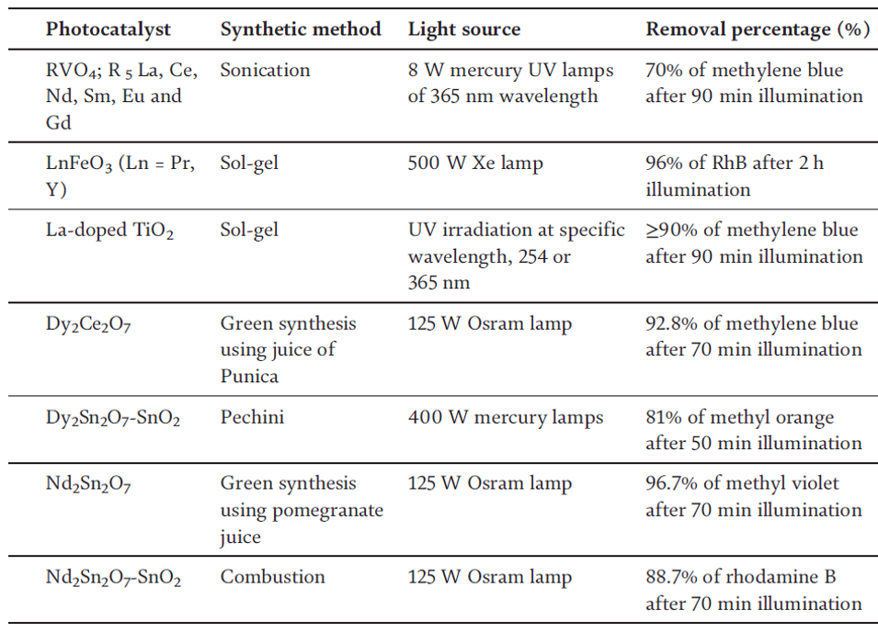

Slide 28
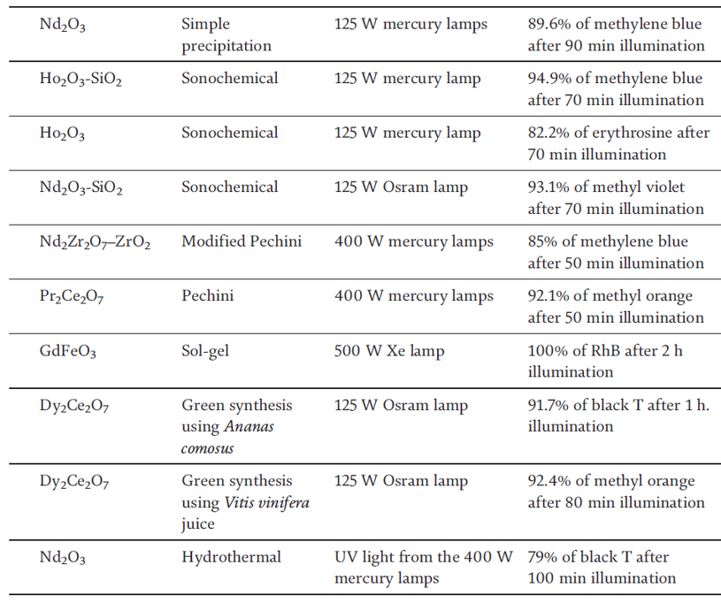

Slide 29
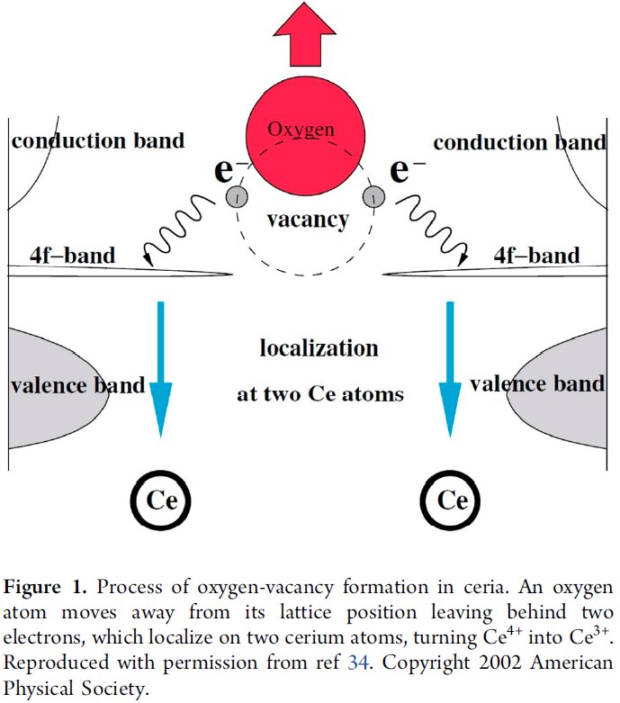
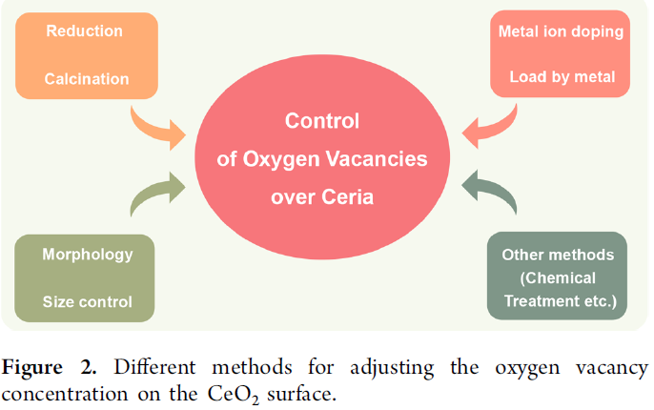
Biomass conversion over ceria catalyst氧化铈催化剂上的生物质转化
- Oxygen vacancy in ceria places the important role in catalysis氧化铈中的氧空位在催化反应中起着重要的作用
金属离子掺杂
还原
焙烧
金属负载
其它方法（化学处理等）
控制氧化铈中的氧空位
形貌
大小控制
调整氧化铈中氧空位的不同方法

Slide 30
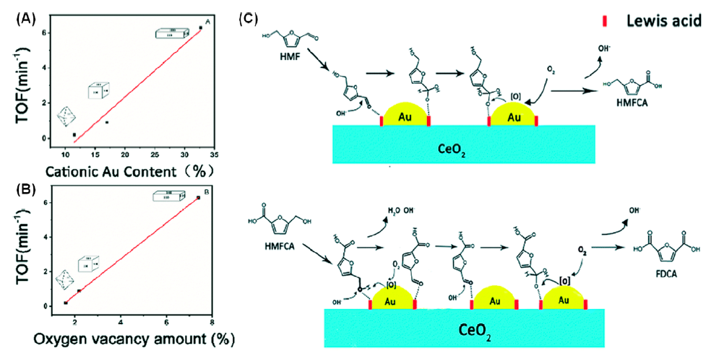
Correlation of activity with oxygen vacancy
活性与氧空位的关系

Slide 31
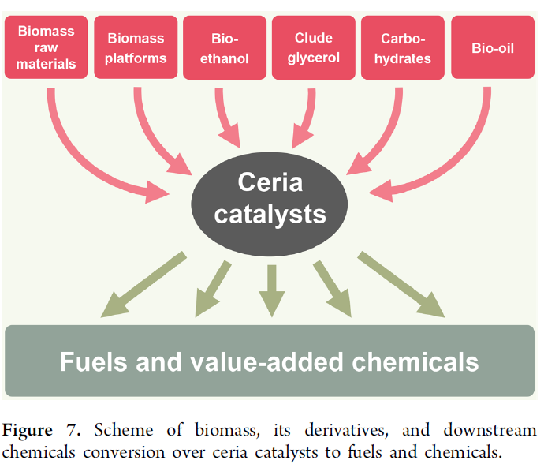
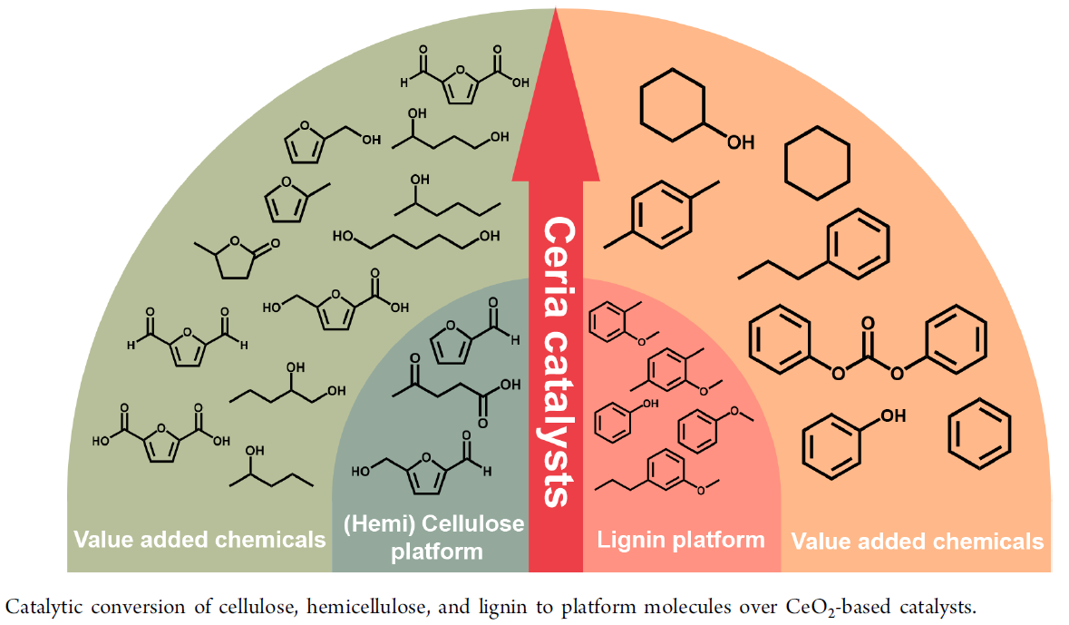
Biomass conversion to different product platforms
生物质转化为不同产品平台

Slide 32
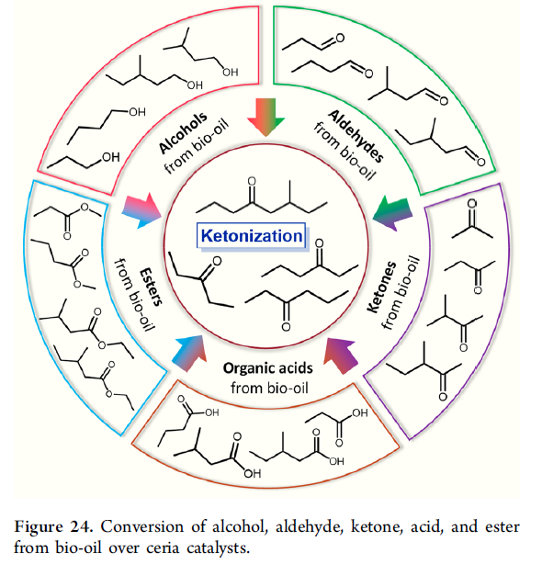
Upgrading of Bio-Oil over Ceria生物油在二氧化铈上的改性
Bio-oil is the pyrolysis product of biomass raw materials
生物油是生物质原料的热解产物
Can be converted to a variety of oxygen–containing compounds with different functional groups being utilized as platform molecules
可以转化成各种含氧化合物，不同的官能团被用作平台分子
Subjected to ketonization to obtain higher ketone
经过酮化得到较高的酮
Further deoxygenated to obtain a high-quality fuel
进一步脱氧以获得高质量的燃料
For long-chain biological oils, hydrocarbons can be obtained through decarbonylation or decarboxylation processes对于长链生物油,可以通过脱羰基或脱羧过程获得碳氢化合物

Slide 33
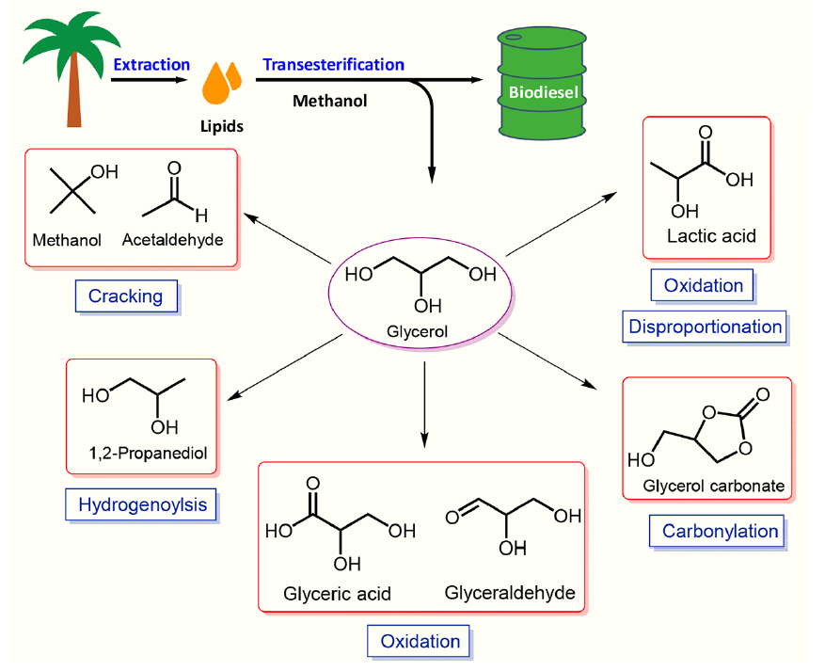
Glycerol Catalytic Conversion Pathways over Ceria
甘油在氧化铈上的催化转化途径
Surplus of glycerol甘油过剩
Upgrading glycerol to produce value-added chemicals or fuels
提高甘油的质量以生产高附加值的化学品或燃料

Slide 34
3. Progress of applications of rare earth materials in new energy field稀土材料在新能源领域的应用进展
Rare earth is an essential element in the field of new energy vehicles
稀土是新能源汽车领域不可或缺的元素
Rare earth permanent magnet motor稀土永磁电动机
Simple structure, reliable operation, small volume, light weight, small loss and high efficiency. Moreover, the shape and size of the motor can be designed flexibly, which makes it highly valued in the field of new energy vehicles
结构简单，运行可靠，体积小，重量轻，损耗小，效率高。而且，电机的外形尺寸设计灵活，在新能源汽车领域具有很高的应用价值
Rare earth power battery稀土动力电池
Lithium ion battery: The addition of rare earth elements greatly guaranteed the structural stability of the material and improved the three-dimensional channel of active lithium ion migration, which makes the prepared lithium ion battery have higher charging stability, electrochemical cycle reversibility and longer cycle life.锂离子电池:稀土元素的加入大大保证了材料的结构稳定性，改善了活性锂离子迁移的三维通道，使制备的锂离子电池具有更高的充电稳定性、电化学循环可逆性和更长的循环寿命。
Lead acid battery: The addition of rare earth is beneficial to improve the tensile strength, hardness, corrosion resistance and oxygen evolution overpotential of lead base alloy for electrode plate, and the addition of rare earth in active component can reduce the amount of positive oxygen precipitation, improve the utilization rate of positive active material, so as to improve the performance and service life of battery.铅酸蓄电池：稀土的加入有利于提高电极板用铅基合金的抗拉强度、硬度、耐腐蚀性和析氧过电位，活性组分中稀土的加入可减少正氧沉淀量，提高正极活性物质的利用率，从而提高电池的性能和使用寿命。

Slide 35
Progress of applications of rare earth materials in new energy field稀土材料在新能源领域的应用进展
Catalyst in three way catalytic converter三元催化转化器中的催化剂
The key role of rare earth elements is to store materials, replace part of the main catalyst and act as catalytic promoter. The rare earth used in the catalyst for tail gas purification is mainly the mixture of ceria, praseodymium oxide and lanthanum oxide, which are rich in rare earth minerals in China.稀土元素的关键作用是储存物质，取代部分主催化剂，起催化促进剂的作用。尾气净化催化剂所用的稀土主要是我国富含稀土矿物的氧化铈、氧化镨和氧化镧的混合物。
Ceramic materials in oxygen sensor氧传感器中的陶瓷材料
Due to the special electronic structure and unique oxygen storage function, rare earth elements are often used in the preparation of ceramic materials in the oxygen sensor of electronic fuel injection system, which makes the catalytic effect better由于其特殊的电子结构和独特的储氧功能，在电子燃油喷射系统氧传感器的陶瓷材料制备中经常使用稀土元素，使得催化效果更好。

Slide 36
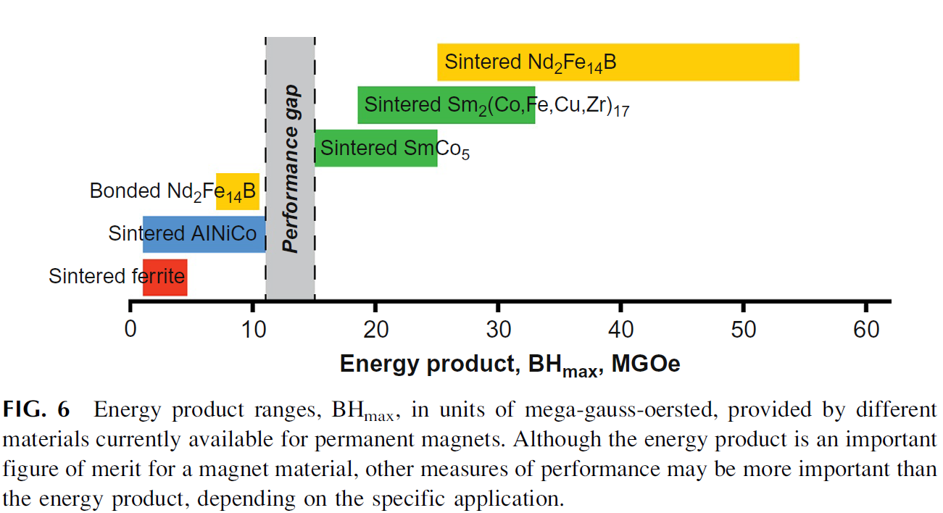
The most powerful magnets最强大的磁铁

Slide 37
4. Future Perspective未来展望
How adding a dash of rare-earth metals to materials is like adding a bit of magic fairy dust—the metals help everything perform better在材料中添加少量稀土金属就像添加一点神奇的仙尘，这些金属可以帮助一切变得更好
Rare earth elements have seen increasing use and have become known as "industrial vitamins”稀土元素的使用越来越多，被称为“工业维生素”
China is leading in the rare earth production due to their various developed technologies. This will maintain.由于技术的发展，中国在稀土生产方面处于领先地位。这将保持
Defects chemistry plays the important role in applications of rare earth materials
缺陷化学在稀土材料的应用中起着重要的作用
Today’s most powerful magnets are made from metallic alloys that contain rare earth elements今天最强大的磁铁是由含有稀土元素的金属合金制成的

Slide 38
Thank you!
谢谢！

